Slide 1



Geographic Information System (GIS) for Disaster Management
By
Brian Tomaszewski
GROUP MEMBERS:
Ali Khalid
Arish Mehboob Bhayani
Shravan Milind Kanchan
Tejas Parvathappa

Slide 2

WHAT IS GIS?
Information System
Hardware, Software, telecommunication network
collect, create, and distribute useful data
Amalgam of several parts:
Hardware ( Computers, Smart Phone, cloud clusters)
software (QGIS, ArcGIS)
People (Analyst, Students)
Knowledge (training, skills, and experience)
Data
Network

Slide 3
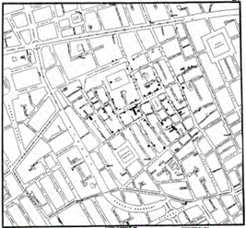

HISTORY OF GIS
Disaster management scenario
London cholera outbreak, Dr john Snow (1854)
Creation of GIS term
Dr. Roger Tomlinson (1933 -2014)
Canadian Geographic Information System
Harvard Laboratory for Computer Graphics and Analysis
ODYSSEY (1960 -1970)
Spatial analysis and computer cartography
graphics research and applications
Graphical User Interface (1990)
Web-based and internet GIS (2000)

Slide 4
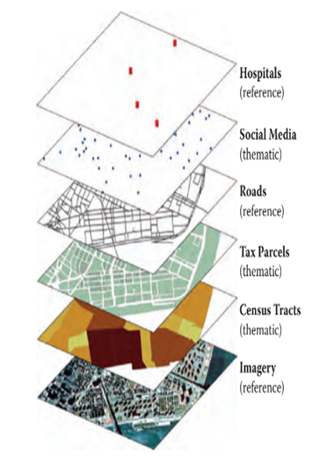
MAP LAYERS
GIS datasets from Manhattan, New York, USA during Hurricane Sandy (2012)

Slide 5
OGC STANDARDS
Maintains numerous geospatial and locational standards
Web Map Services (WMS) Standard
share georegistered images using HTTP protocol
Geographic Markup Language (GML) Standard
XML based grammar
streaming geographic data services

Slide 6
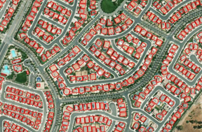
USES OF GIS SOFTWARE
Data and Spatial Asset Management
create spatially referenced data

Slide 7

USES OF GIS SOFTWARE
Data repositories for GIS
Vector
CSV
Shapefile, Esri
KML, Google
Raster
tiff
geotiff

Slide 8
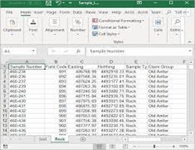
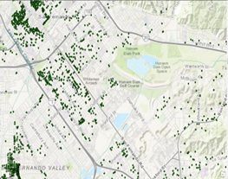
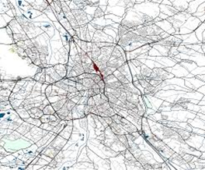
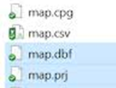
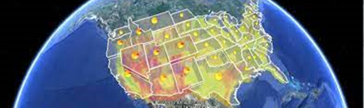
USES OF GIS SOFTWARE
Vector
CSV
Shapefile, Esri
Keyhole Markup Language (KML), Google

Slide 9
USES OF GIS SOFTWARE
Analysis
Investigate geographically oriented questions or problems.
GIS Programming
Batch data processing
New tools development

Slide 10
GIS BASED DISASTER MODELING TOOLS
HAZUS
Estimating loss from natural hazards, specifically earthquakes, floods, and hurricanes.
ALOHA
Areal Location of Hazardous Atmospheres designed
to model the spatial distribution of hazardous gases.
SUMMIT
Standard Unified Modeling, Mapping and Integration Toolkit modeling environment supported by the US Govt “that enables analysts, emergency planners, responders,
and decision makers to seamlessly access integrated suites of modeling tools

Slide 11
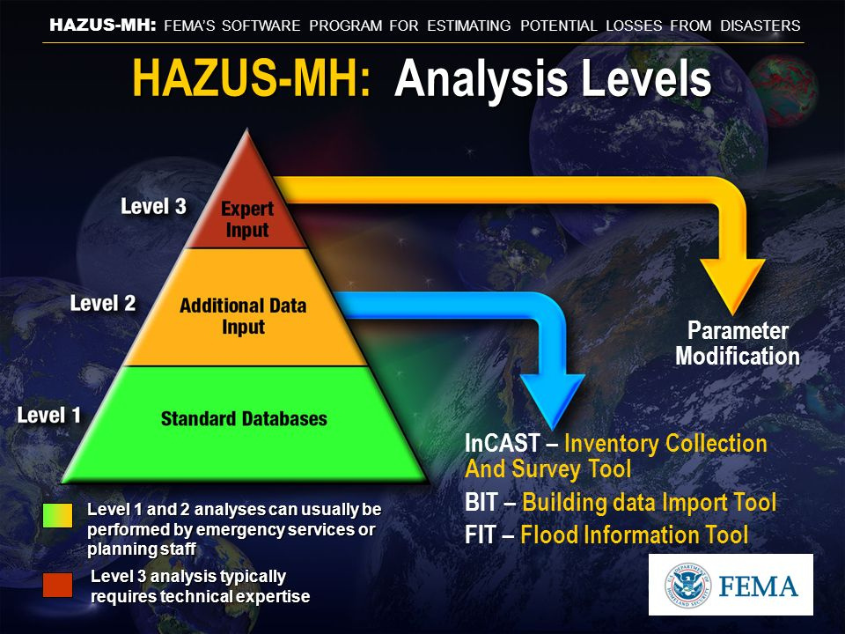
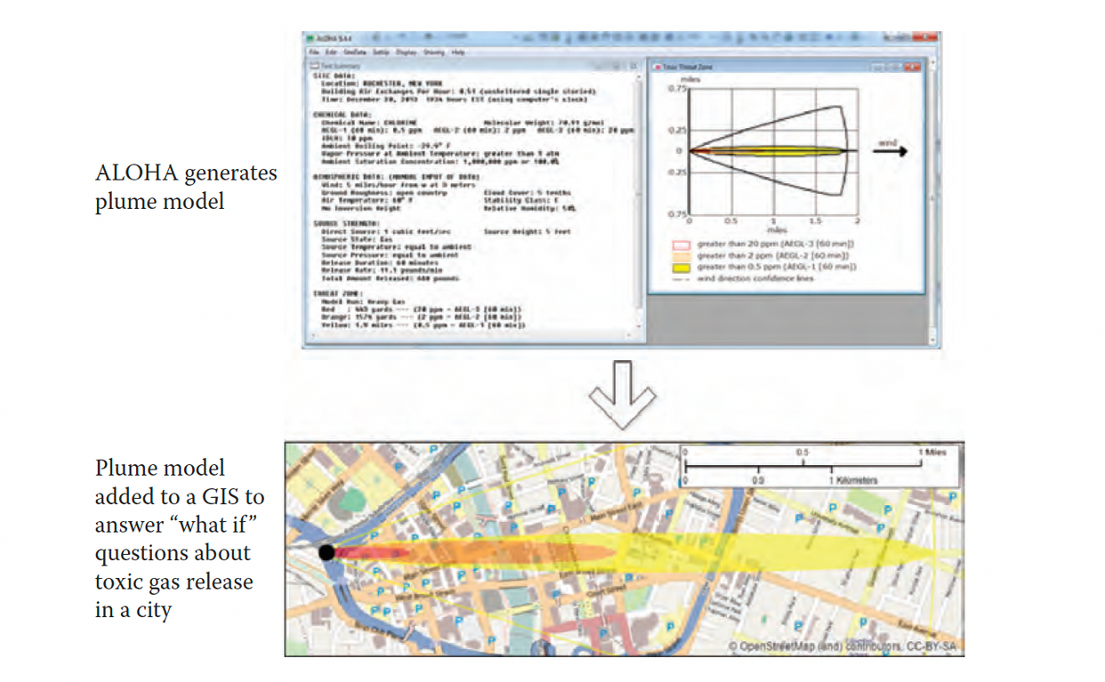

Slide 12
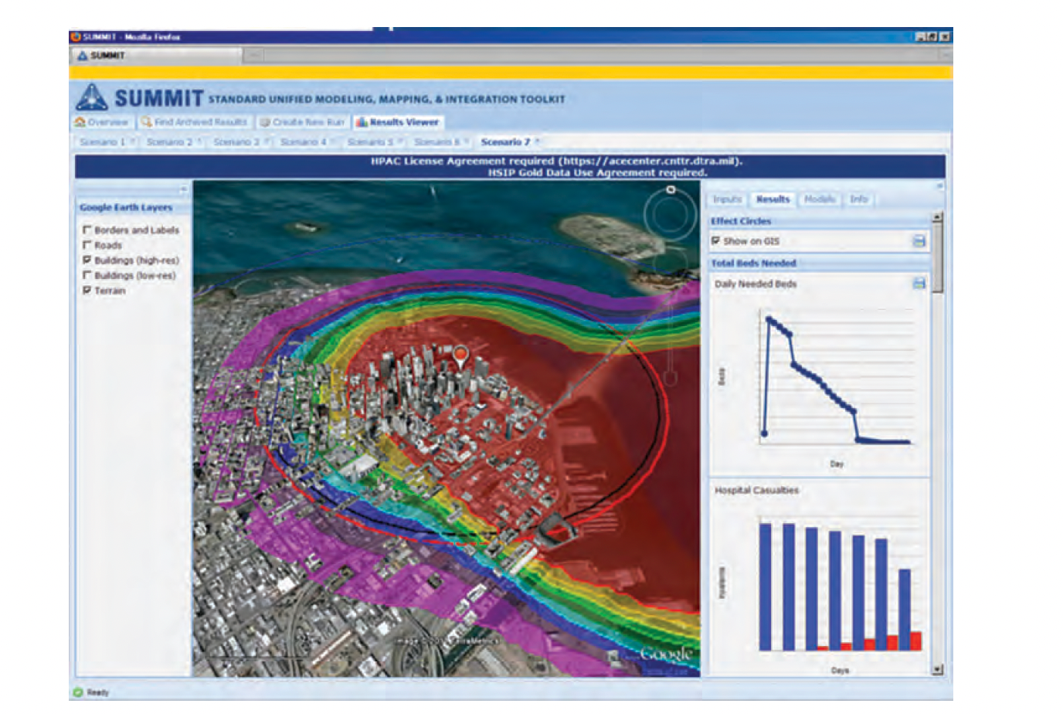

Slide 13

CARTOGRAPHY, VISUALIZATION
AND MAP PRODUCTION
GIS functions are map production and cartography support tools.
Map can be used to represent the final results of a GIS analysis to give to a decision maker or be used to represent different parameters, scenarios, and outcomes from GIS-based modeling to make modeling results easier to understand.

Slide 14



GEOCODING
Geocoding is the idea of taking text-based input such as a place name or street address and converting it to a coordinate representation.
43.0848° N, 77.6715° W

Slide 15


LIMITATIONS OF GIS
GIS is not a miracle technology and its effectiveness depends on the quality of data and the skills of the people using it.
Over reliance on technology and lack of proper education and training can have negative consequences.
Acquiring and editing data is the most costly aspect of GIS and is crucial for success in utilizing GIS for disaster management.

Slide 16
UNDERSTANDING GIS DATA MODELS
A GIS data model can be thought of as a way in which geographic-scale features or
phenomena are represented in a digital manner.
Reducing geographic reality to 1s and 0s is problematic, and many of the nuances, subtleties, and idiosyncrasies are lost in digital representations—a problem that really has existed since the beginning of mapping.

Slide 17



VECTOR MODEL
The vector GIS data models represent geographic features as discrete, vertex-based shapes.
Each vertex in a vector shape is referenced to a specific x,y Cartesian or geographic coordinate
location
An important aspect of vector-based GIS datasets from a technical perspective is that for any given geographic feature stored in a vector dataset, non spatial attribute data can be stored along with the data that describes the vertices of the point, line, or polygon shape itself.

Slide 18



RASTER MODEL
The raster GIS data model represents geographic features and phenomena as a grid of individual
cells.
Raster is typically used for modeling geographic entities that are continuous in nature and have no discreet boundaries or edges
An important concept with raster data is spatial resolution. Spatial resolution is fineness of
detail of a raster dataset and is based on the size of each cell within the grid.

Slide 19


GIS METADATA
Metadata is data about data.
It can be different for Vector and Raster data sets.
The structure and physical storage of GIS
metadata is as varied as GIS data itself.
Metadata plays a particularly important role in GIS for disaster management.This importance is due to the fact that metadata is critical to coordination and collaboration activities.

Slide 20
Specific GIS Technology
GIS Technologies has been around for little bit more than 10 years now.
GIS Technology has been extensively used for disaster management.
Various combination of features and varieties exists in GIS, but research is needed to find out the best suited set of requirements for that particular application.

Slide 21

GIS Platforms
GIS is available for all types of computing platforms.
Choosing correct platform for appropriate application is necessary. Eg. - Destop for core analytics and mobile for location based services.
Web Platforms are also extensively used these days as they can be accessed anywhere with Internet connection.

Slide 22
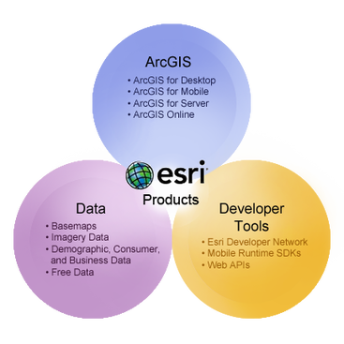
Arc GIS
Esri is the world's largest commercial GIS software company
Esri Offers a comprehensive range of GIS Technologies relevant to modern day platforms and disaster management.
Eg. : ArcGIS, ArcGIS Online, ArcMap, API's.

Slide 23
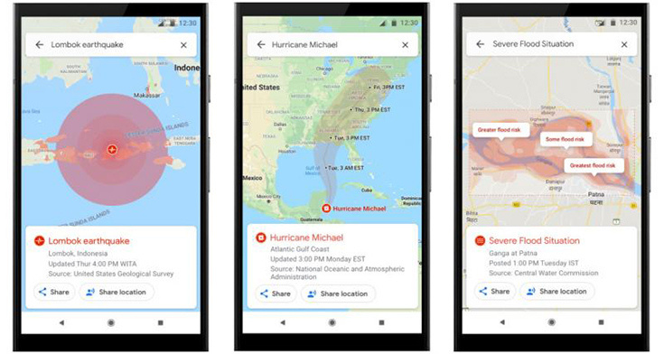
Google Maps
Google has made their mapping tool more accessible to nontechnical experts through Google Maps Engine
Google has a Google Crises response team that is dedicated for building tools specific to major disasters.
Google enables easy sharing of this disaster data in multiple compatible formats for further analysis.

Slide 24
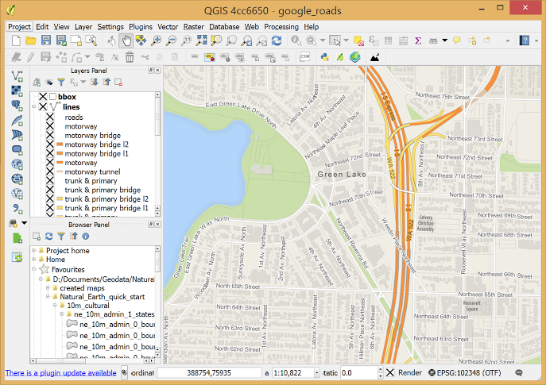
QGIS
It is an Open source GIS Package similar to ArcGIS but simpler to use.
It is mostly suited for smaller datasets and quick analysis applications.
QGIS is commonly used for disaster management training.

Slide 25

Other Technologies
NASA World Wind: Open-source virtual globe tool for viewing NASA-created datasets.
QGIS: Open-source desktop GIS software for analyzing, editing, and visualizing spatial data.
GRASS GIS: Open-source desktop GIS software specializing in raster-based analysis and modeling.
Google Earth: Free virtual globe tool for exploring and visualizing geographic data in 3D.
ArcGIS Online: Cloud-based GIS platform by Esri for creating and sharing maps, apps, and data.

Slide 26

Finding GIS Data on Internet
Finding or creating GIS data is the most time-consuming aspect of GIS.
GIS clearinghouses in most US states allow free access to public GIS data.
Spatial data infrastructures (SDIs) like GeoPlatform.gov provide access to GIS data produced by the US federal government.
Hunting on the Internet may be necessary to find GIS datasets for disaster management needs.
Always look for metadata that describes the dataset and ensure that the GIS technology being used can work with the dataset.
Some datasets in the old ArcINFO coverage format may still be found on the Internet but may require special data conversion software to work in certain GIS tools like Google Earth.

Slide 27

How to Choose the Right GIS Technology for Disaster Management
The importance of considering cost and technical capacity when choosing GIS technology for disaster management. This may involve weighing the advantages and disadvantages of commercial software versus open-source tools, as well as considering the level of technical support that may be necessary.
The specific disaster management tasks that need to be conducted and how they may change over time. For example, smaller organizations may be able to use simpler technologies for basic mapping needs, while larger organizations may require more robust GIS tools for complex modeling and data dissemination.
The degree to which GIS and mapping are integral to an organization's overall mission. If GIS is only a minor component of an organization's activities, it may not make sense to invest in expensive and complex GIS technologies that require ongoing training and maintenance.
The importance of avoiding a situation where GIS technology has been neglected and needs to be re-learned during a crisis. This may involve ensuring that staff and consultants have ongoing access to training and support to maintain their GIS skills.
The value of consulting with GIS experts and/or GIS consulting firms to help assess an organization's GIS needs and choose the right technology solution. This may be especially important for organizations that lack in-house GIS expertise or have limited resources to invest in GIS technology.

Slide 28

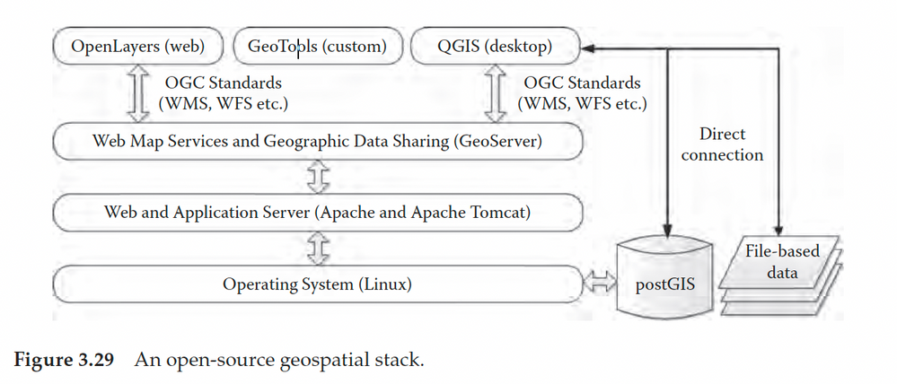
Getting Started with GIS Technology and GIS Technology Configuration Ideas
Getting Started with GIS Technology
ArcGIS Explorer is a recommended free tool for beginners to learn basic GIS operation, such as map layering, raster and vector datasets, and spatial analysis
Compared to Google Earth, ArcGIS Explorer offers more GIS-specific features such as querying, base map choices, and integration of standard GIS datasets
After becoming comfortable with ArcGIS Explorer, try working with more robust GIS technology such as ArcMap or QGIS
Ideas for Geospatial Stack Configuration for Disaster Management
A geospatial stack is a series of technologies combined to provide various functions and services for disaster management
Implementing open-source technologies for a geospatial stack requires IT knowledge in areas such as web servers, databases, system administration, and programming
ArcGIS Online and Google cloud-based mapping have become popular for their ease of use and elimination of technical barriers
Recommendations for beginners include finding the right people to help or considering completely integrated solutions

Slide 29
Conclusion
GIS is a powerful tool for managing spatial data and answering spatial questions. It has many functions, including data and spatial asset management, analysis, programming, modeling, cartography, visualization, and geocoding.
GIS data models are the ways in which geographic and spatial entities are represented in digital formats. The two most common data models are vector data and raster data, and metadata is important for determining the usefulness and relevance of a dataset.
Specific GIS technologies can be used for disaster management applications, including Esri, Google, and QGIS. Free and open-source datasets are also available for disaster management tasks.
When deciding which technologies to use for disaster management, it is important to consider the specific needs and requirements of the task or application. Building a GIS technology stack using open-source GIS technology can be a cost-effective solution.
In the next chapter, the relationship between disaster management and GIS will be discussed in more detail, including the role of GIS within disaster management policy at different scales within the United States and the international community's engagement in disaster risk reduction, response, and recovery.

Slide 30


